Slide 1
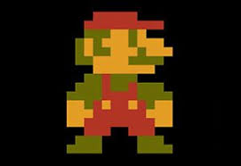
Comparison of DQN and Double DQN With Dueling Architecture on Super Mario Bros
Du Han

Slide 2
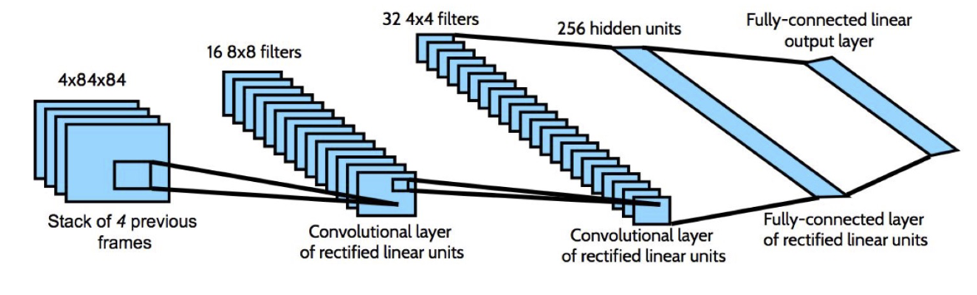


DQN
Two Networks:
and
Which are synchronized periodically

Slide 3
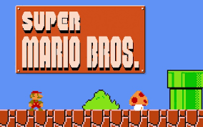
Environment

Slide 4
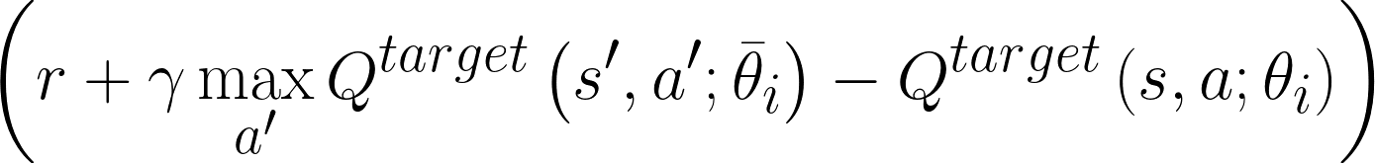
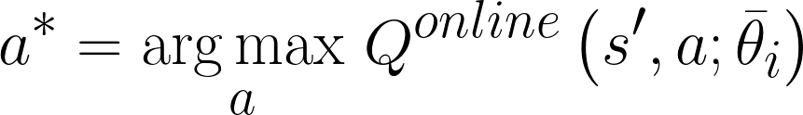
Double DQN
Temporal Difference for DQN:
Temporal Difference for Double DQN:
where

Slide 5
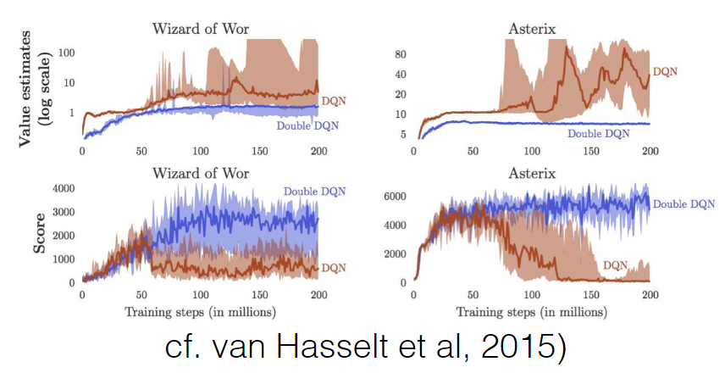
Double DQN

Slide 6
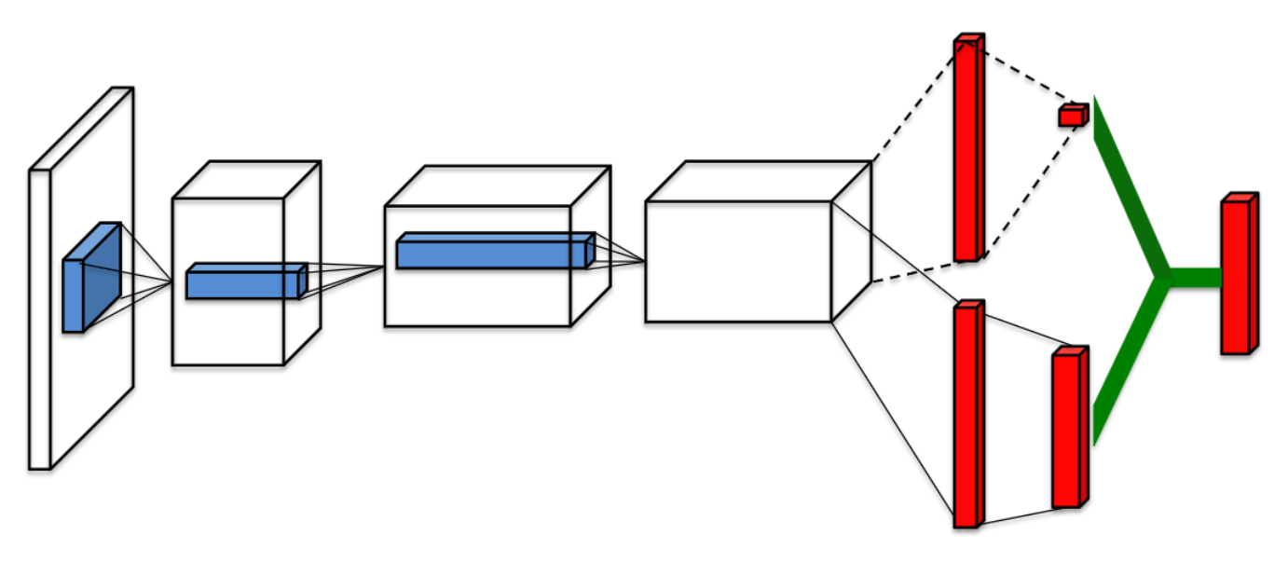
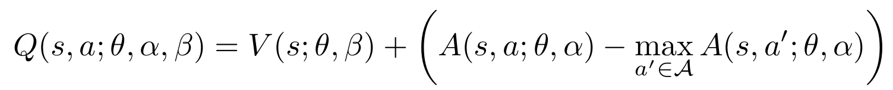
Dueling DQN
cf. Wang et al, 2016
Split Q to A and V

Slide 7
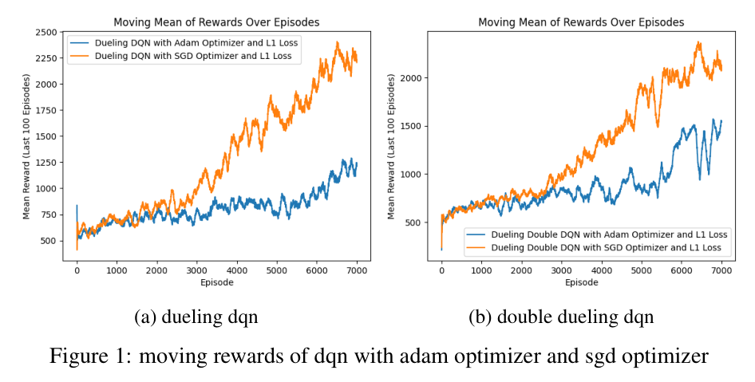
Experiments

Slide 8
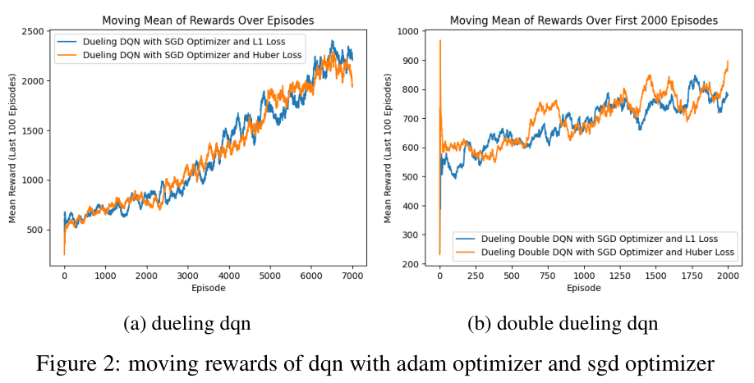
Experiments

Slide 9
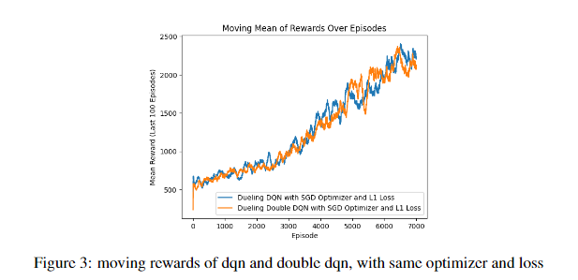
Experiments

Slide 10
Showcase

